Slide 1

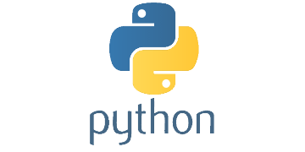
Hands On Workshop: Using MATLAB and Python Together
Notes:
Nice additions/improvements:
Add beautiful soup to Python to scrape more text data
Use the text data in the machine learning predictions
Pull in streaming data from Python with web socket API (instead of using RESTful API) – this would be difficult in deployment because it would require a streaming interface though.

Slide 2

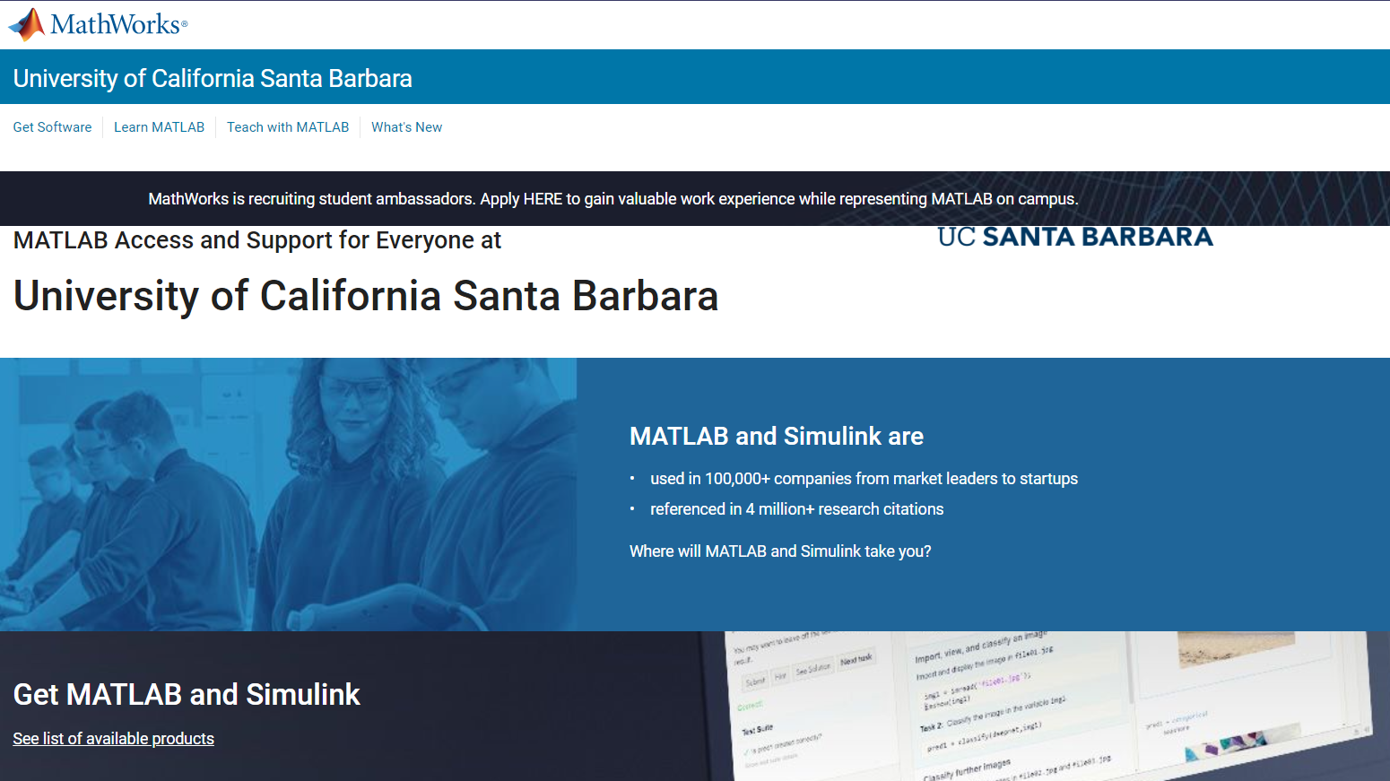
Unlimited Access to MATLAB and Simulink for UCSB Community
http://bit.ly/44z6DOK

Slide 3

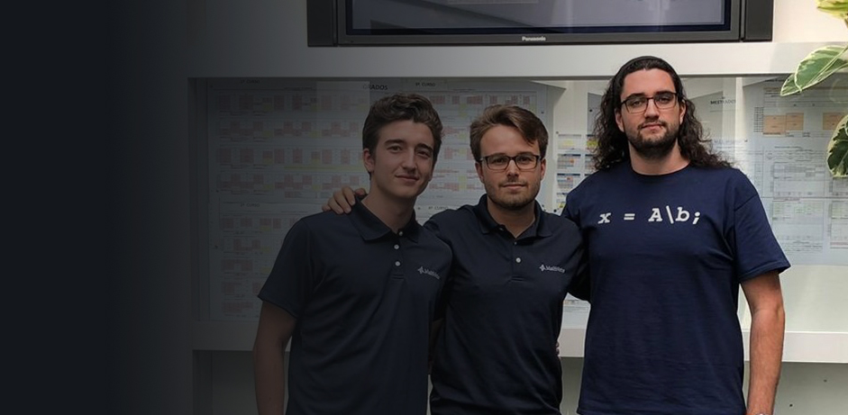
Become a MATLAB Student Ambassador
Apply here!
We’re hiring on-campus self-starters to spread awareness of MATLAB and Simulink by organizing fun events and building active online communities.
(For UCSB students only)
http://bit.ly/3Q646Y1

Slide 4
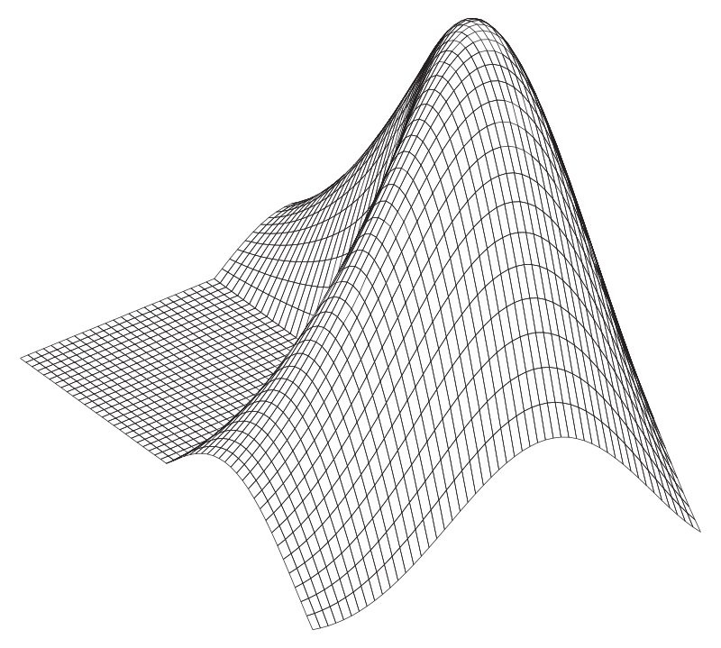







Did you know?
Your MathWorks Team
As part of UCSB's MATLAB Campus Wide License, MathWorks engineers are available to support:
Teaching: Help you integrate MATLAB teaching tools into the course curriculum
Research: Explore how you can use MATLAB in your research projects
Learning: Arrange seminars, workshops, and guest lectures on relevant topics
Student engagement: Collaborate with student clubs on events and competitions
Kortney Capretta
Senior Account Manager for your licensing needs
kcaprett@mathworks.com
Esperanza Linares, Ph.D. Senior Customer Success Engineer as your main technical resource
elinares@mathworks.com
Ryan Page Customer Success Specialist for onboarding and promotion of resources on campus
ryanpage@mathworks.com

Slide 5
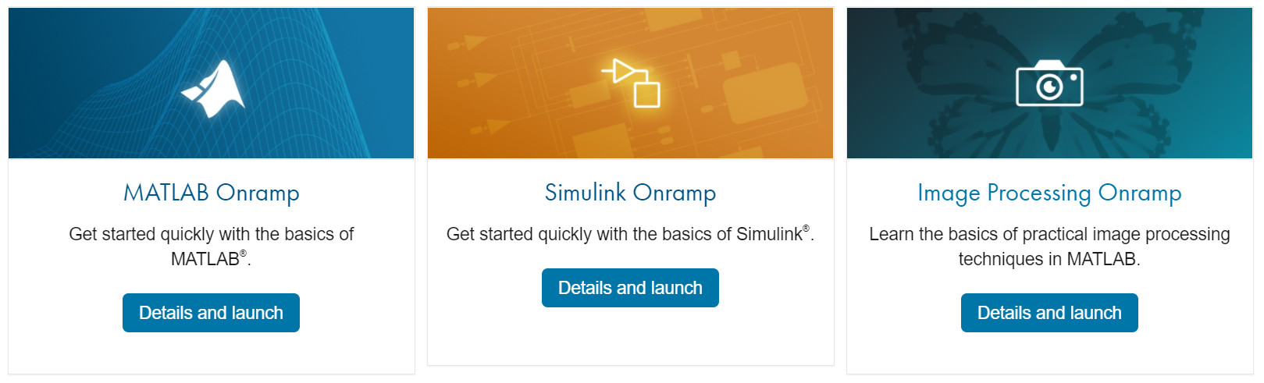

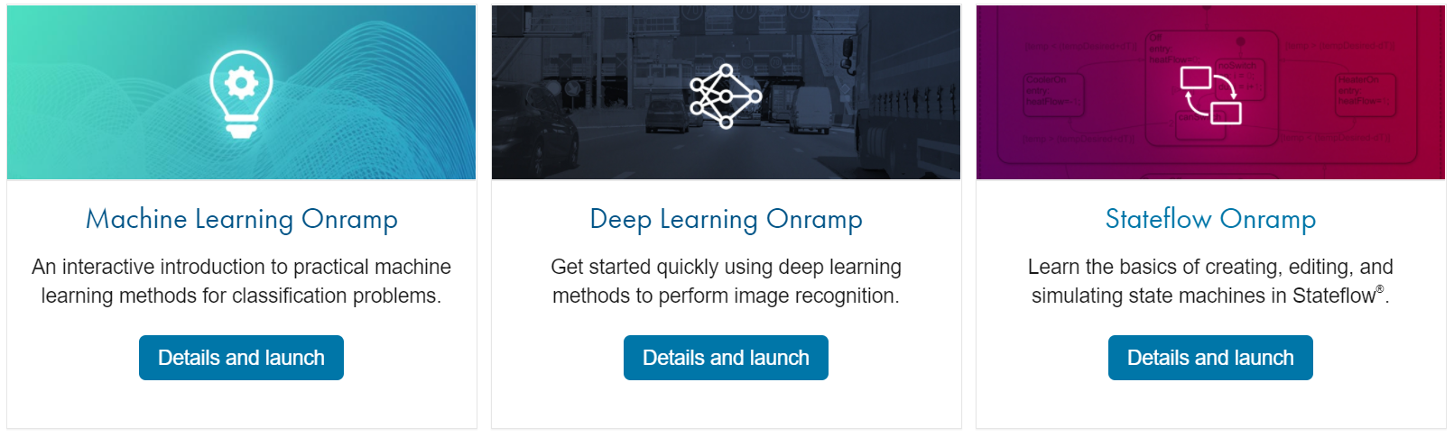
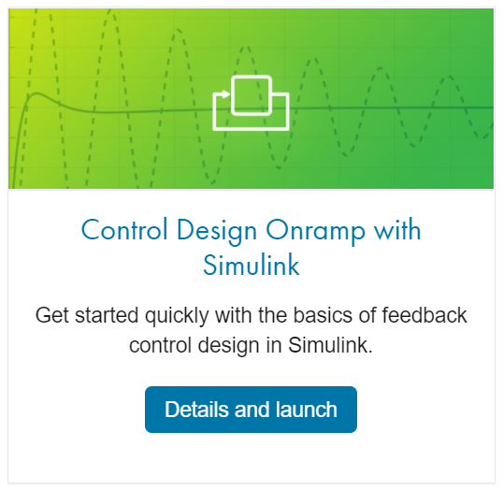
Get Started with Onramp Courses
https://matlabacademy.mathworks.com/

Slide 6


MATLAB Central Community
Every month, over 2 million MATLAB & Simulink users visit MATLAB Central to get questions answered, download code and improve programming skills.
Blogs
Answers
Blogs
MATLAB Answers: Q&A forum; most questions get answered in only 60 minutes
MATLAB Answers
File Exchange: Download code from a huge repository of free code including tens of thousands of open source community files
File Exchange
ThingSpeak
Cody: Sharpen programming skills while having fun
Blogs: Get the inside view from Engineers who build and support MATLAB & Simulink
Learn
Contribute
Connect
Cody
and more…
ThingSpeak: Explore IoT Data
And more for you to explore…

Slide 8






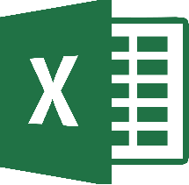
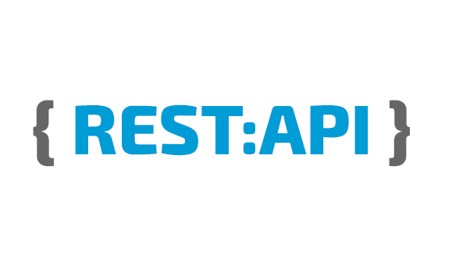



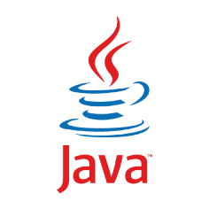

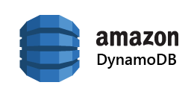
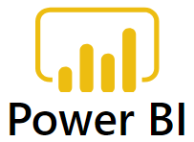





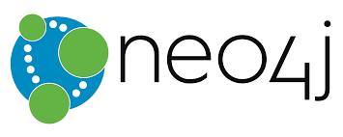
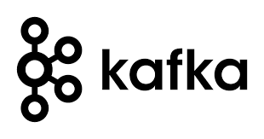

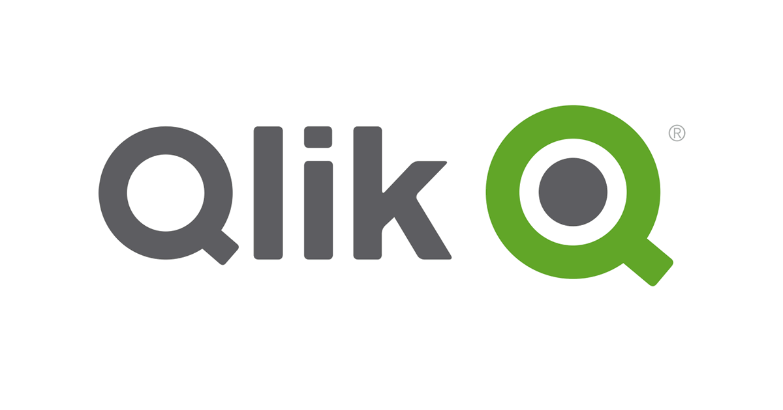


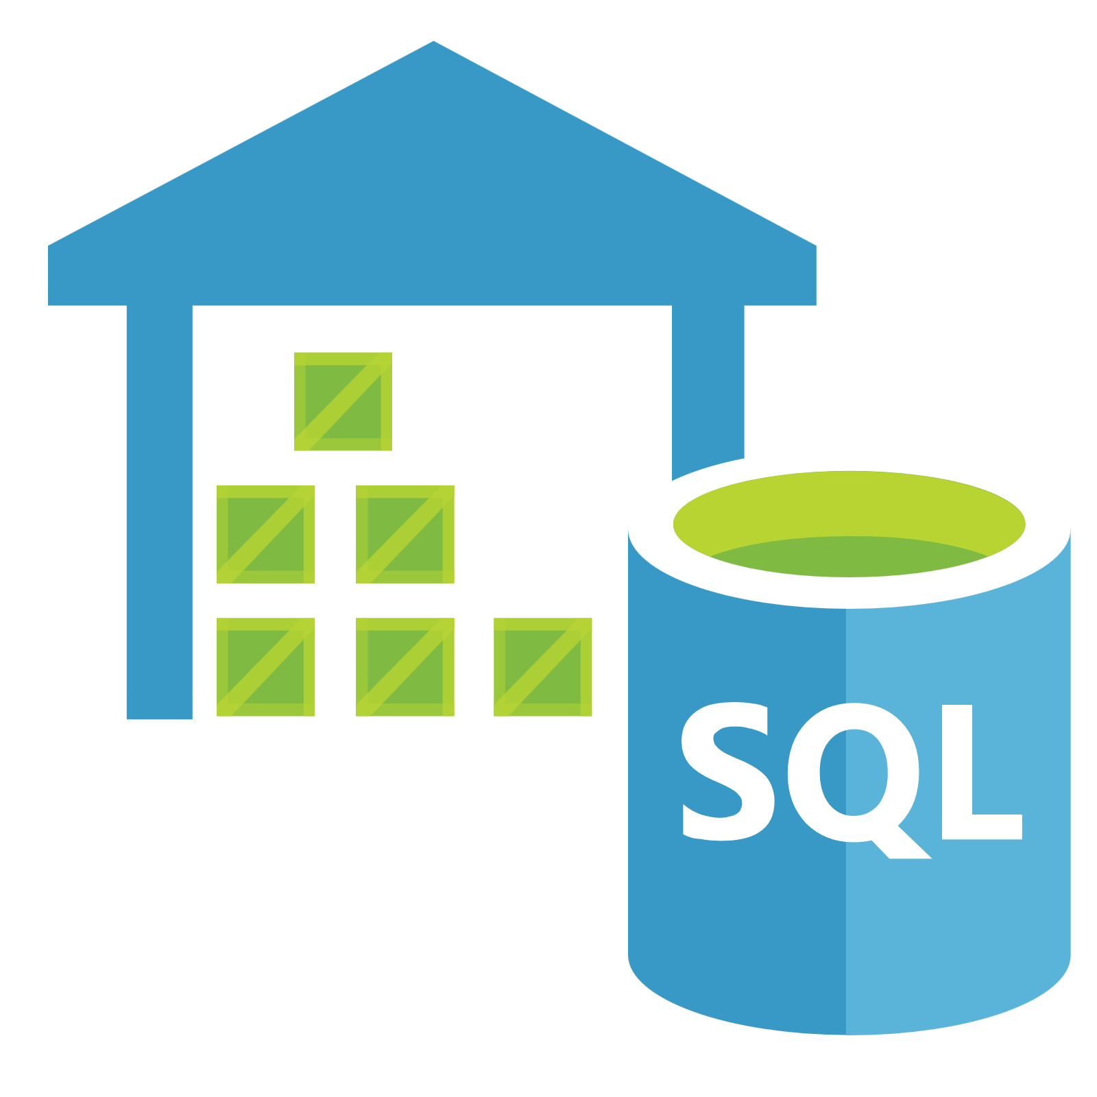



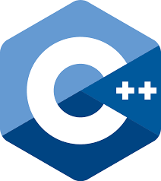
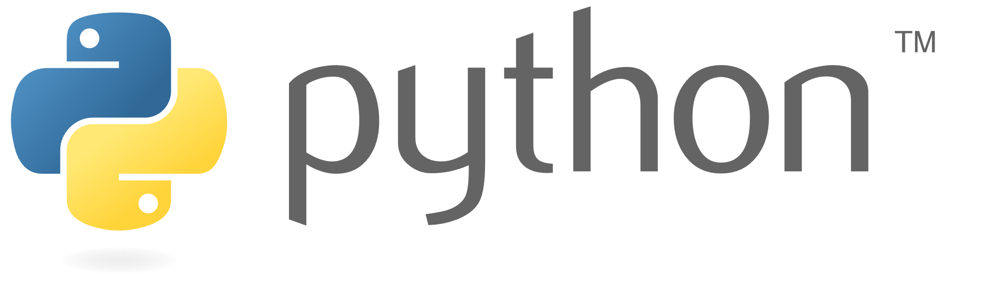




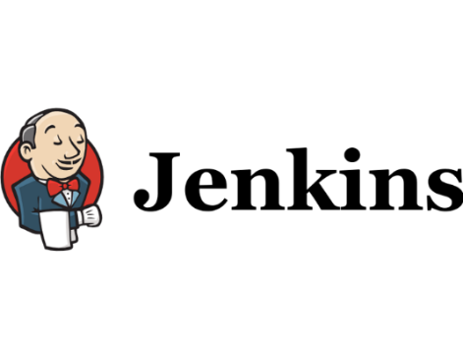




MATLAB and the Analytics Ecosystem
Azure Data
Lake Store
Data Sources
Business Systems
Cloud / VM
Notes:
Many systems need to integrate and play nicely together. Generally, this can be quite challenging for Solution Architects who are in charge of building a robust back-end infrastructure. MATLAB has built in interfaces to many systems:
data sources <click>
BI systems <click>
And VM/cloud/mobile <click>
such as the ones you see here.
<click>
and for the last 5 years Python too has had it’s place in that analytics ecosystem as well.
---------------------------------
Note: should we include Teradata, Netezza, Domino Data Labs?

Slide 9
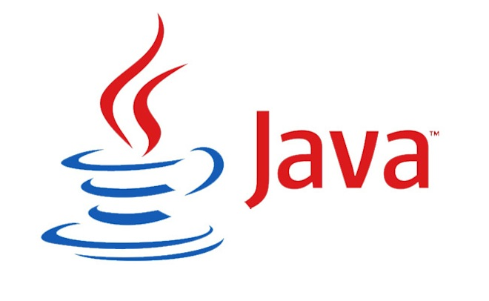
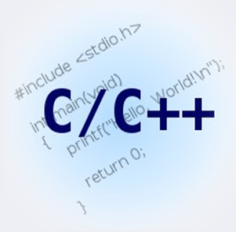

MATLAB APIs
Notes:
Even when there aren’t explicit interfaces for a particular application, MATLAB also provides direct APIs to many other languages to allow the MATLAB developer to take advantage of other external libraries. We have supported C/C++, Java, .NET, Fortran, COM and others for many years.
<click>
In R2014b and newer releases of MATLAB we also support a direct Python interface as well. (do we mention support for 2.7 vs 3.X here or save for slide later?)

Slide 10
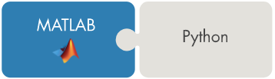
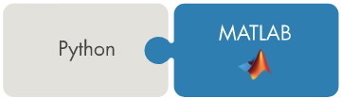
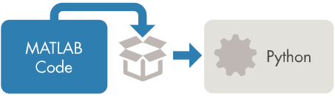
Using MATLAB with Python
Three ways to integrate:
Calling Python from MATLAB
Calling MATLAB from Python
Packaging MATLAB programs for scalable deployment with Python
Algorithm
Developers
Users
Notes:
3 ways to integrate which are….
<click>
First two are methods to integrate for researchers, quants, developers. The last method is a scalable approach to push the analytics into production for business users, managers, and other decision makers.

Slide 12
Python and MATLAB Integration
R2014b+ required
Python 2.7, 3.4, 3.5, 3.6, 3.7, 3.8, 3.9 have been supported
Check the documentation for your MATLAB release as it evolves
MATLAB Supported Language Interfaces
Architecture of MATLAB and Python must be the same (i.e. 64bit)

Slide 13
Use pyenv to Set Python Environment
>> pe = pyenv('Version', '2.7', 'OutOfProcess', true);
>> mylist = py.list;
>> pe
pe =
matlab.pycli.PythonEnvironment with properties:
Version : '2.7'
Executable : 'C:\Python27\pythonw.exe'
Library : 'C:\WINDOWS\system32\python27.dll'
PythonHome : 'C:\Python27'
Status : Loaded
ExecutionMode : OutOfProcess
ProcessID : '12345'
ProcessName : 'MATLABPyHost'

Slide 14
Manage the Python Path
Current directory (pwd) in MATLAB is Python current directory (py.os.getcwd)
If all Python files are in this directory, no extra work required
If they live separately, add them to Python path or change to that directory
File Exchange Submission that simplifies this
https://www.mathworks.com/matlabcentral/fileexchange/62703-py_addpath-directory-matlab_too

Slide 15
Data Type Conversion
Scalar
Container
NumPy
>> p = py.str('hello world')
p =
Python str with no properties.
hello world
>> m = string(capitalize(p))
m =
"Hello world"
>> d = py.dict(Hello=pi, ...
World=42)
d =
Python dict with no properties.
{'Hello': 3.141592653589793, 'World': 42.0}
>> s = struct(d)
s =
struct with fields:
Hello: 3.1416
World: 42
>>
>> p = py.numpy.array(magic(3))
p =
Python ndarray:
8 1 6
3 5 7
4 9 2
Use details function to view the properties of the Python object.
Use double function to convert to a MATLAB array.
>> m = double(p)
m =
8 1 6
3 5 7
4 9 2
>>
https://www.mathworks.com/help/matlab/matlab_external/passing-data-to-python.html
Notes:
Note if we pass in 3 instead of 3.0 into myfunction then the MATLAB datatype becomes int64 instead of a double. sqrt() in MATLAB doesn’t work with int64

Slide 16
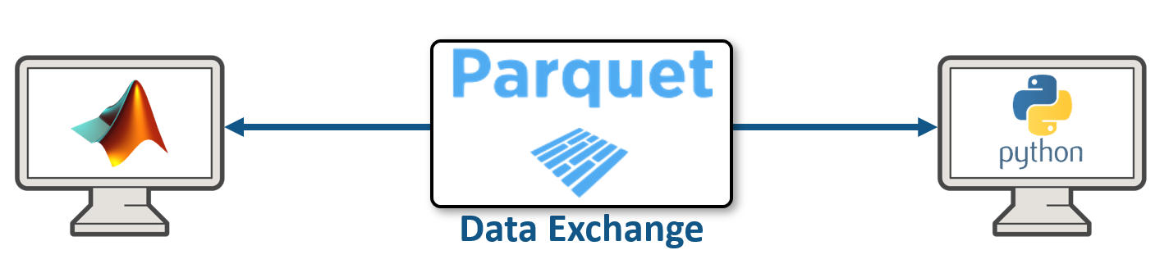
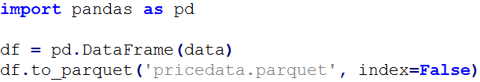
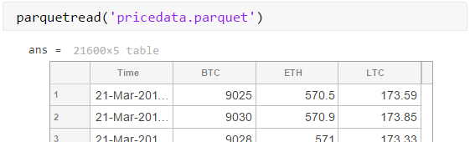
Exchange Tabular Data with Parquet
Ideal for tabular and big data
High data compression and fast reading
Robust type conversion via Apache Arrow
parquetread, parquetwrite, ParquetDatastore, tall.write(___,FileType='parquet')
Notes:
So for those that aren’t familiar with parquet, it is a file type that allows you to store data to disk. Specifically, parquet is very efficient and fast which makes it great for working with big data but also any tabular excel-like data.
Below is an example of saving a dataframe as a parquet file, then loading the parquet file into MATLAB as a table. A single command in MATLAB allows you to read and write to parquet. Additionally, parquet can be ready asynchronously meaning that it can be read in-parallel with MATLAB further improving performance (e.g. mapreducer command).

Slide 18
MATLAB Engine API for Python Overview
Client Process
Server Process
MATLAB
Python
Program
MATLAB Engine
Client
Library
Notes:
MATLAB engine is not a new thing. We have it for many years. It is a set of APIs that can be used to call MATLAB from languages like C/C++, and Fortran. During runtime, there are two processes. The client is the Engine application, and the server is MATLAB.

Slide 19
MATLAB Engine for Python Features
Create/terminate MATLAB
Put variable into MATLAB workspace
Get variable from MATLAB workspace
Call MATLAB command synchronously or asynchronously
Python data types are implicitly converted to MATLAB data types

Slide 20
MATLAB Engine package in Python
matlab
engine
(Function)
start_matlab()
(Classes)
MatlabEngine
workspace[“matlabvar”]
matlabfunc(*args,nargout=1, async=False, stdout=sys.stdout, stderr=…)
exit()/quit()
FutureResult
result(timeout=None)
cancel()
done()
cancelled()
EngineError
EngineExecutionError
RejectedExecutionError
C:\>C:\Python39\python.exe
>>> import matlab.engine
>>> eng = matlab.engine.start_matlab()
>>> eng.sqrt(4.0)
2.0
>>> eng.exit()
Notes:
Here is the Python Engine package. The start_matlab() function is used to launch MATLAB. You can use the workspace property to get/set variables in MATLAB workspace. You can call any matlab functions synchronous or asynchronously. The futureResult is used for asynchronous call. And there are some exceptions defined.

Slide 21
Install MATLAB Engine for Python
With PIP from PYPI https://pypi.org/project/matlabengine
python -m pip install matlabengine
Python Engine from MATLABROOT
$matlabroot$\extern\engines\python>C:\Python27\python.exe setup.py install
Or
cd “$matlabroot$\extern\engines\python"
python -m pip install .
https://www.mathworks.com/help/matlab/matlab_external/install-the-matlab-engine-for-python.html

Slide 23



Desired Deployment Workflow
Deployment
Notes:
Now let’s move on to our second part of the agenda, which is deployment of the model we created.
SHOW DEMO 3 – Compiler SDK
- Start /w App in MATLAB to create .py lib
- Then mention the code is pretty much the same as in the interactive method, but instead of starting a MATLAB session, we are initializing the runtime in process. Provides an added benefit of improved performance because the runtime is leaner to startup than the full MATLAB session.

Slide 24


Choosing the Right Deployment Solution
MATLAB
Runtime
.c/cpp
MATLAB Compiler SDK
MATLAB Coder
Output | Executable or software component/shared library | Portable and readable C/C++ source code
Main Use Case | Deploy MATLAB programs as standalone applications on desktop or production servers | Deploy MATLAB code as portable C/C++ code on embedded platforms or desktop
MATLAB language support | Full | Subset
Supported toolboxes | Most toolboxes | Some toolboxes
Production | MATLAB Production Server | Embedded Coder
Graphics Support | Full | None
Library Dependency | MATLAB Runtime | None
Notes:
Here’s a table that compares MATLAB Coder and MATLAB Compiler so you can choose the right product for your needs.
One of the primary distinction is that MATLAB Coder will generate readable and portable C/C++ code that can be compiled as a standalone without any additional libraries, while MATLAB Compiler generates executables or libraries that requires the MATLAB Runtime to run. Also, MATLAB Coders supports only a subset of the language for code generation that’s suitable for numerical algorithm development, while MATLAB Compiler supports pretty much the entire MATLAB language and toolboxes, including graphics and visualization.
The outputs of both product can be deployed royalty-free.

Slide 25





Desktop Deployment with MATLAB
MATLAB
Toolboxes
1
MATLAB Desktop
End-User Machine
2
MATLAB Compiler SDK
MATLAB
Runtime
3
.py
.py
Notes:
Use as Summary slide for desktop deployment…..
- Focus on royalty free deployment

Slide 26
Enterprise Challenges
Responding to new requirements
Maintaining software version
Supporting multiple use cases
Get algorithms into hands of decision makers faster

Slide 27


Ideal Solution
Small data transfers
Server and database collocated
Flexible analytics
Centralized analytics
Multiple interfaces
Scalable

Slide 28

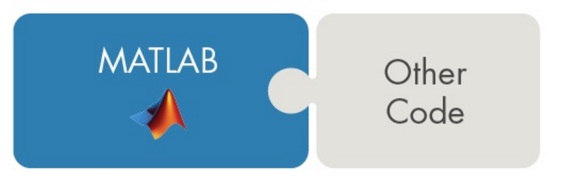

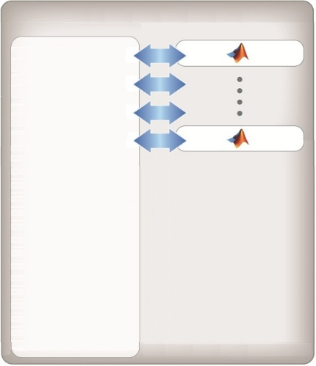
Enterprise Deployment and Scalability of MATLAB
MATLAB
Compiler SDK
MATLAB Production Server
Web Applications
Web
Server
Scenario Generation
C/C++
Java
C# and .NET
Python
Excel
COM Automation Server
RESTful, HTTP, and WSDL web services
Pricing
Excel
Add-in
Desktop Applications
Application
Server
Risk
Analytics
Batch Applications
Database Server
Notes:
Start MPS dev & test environment (mention it acts the same as MPS for making calls, but just ties up the MATLAB session so it doesn’t have scalability (that’s what MPS is for) but otherwise looks+acts the same as MPS)
Show Python client first
Then show Web client demo (calling from the website in action via something like this: http://localhost:3030/index?crypto=ETH)
Then show mps.js

Slide 29
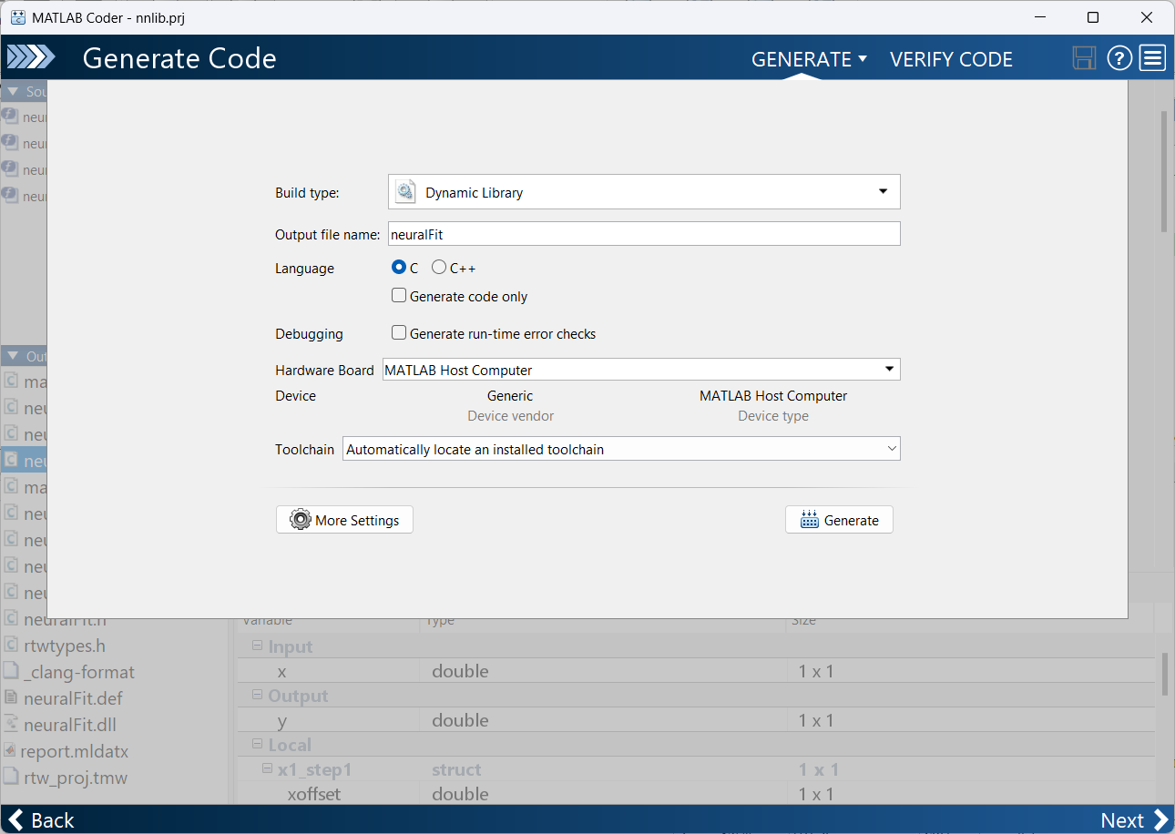
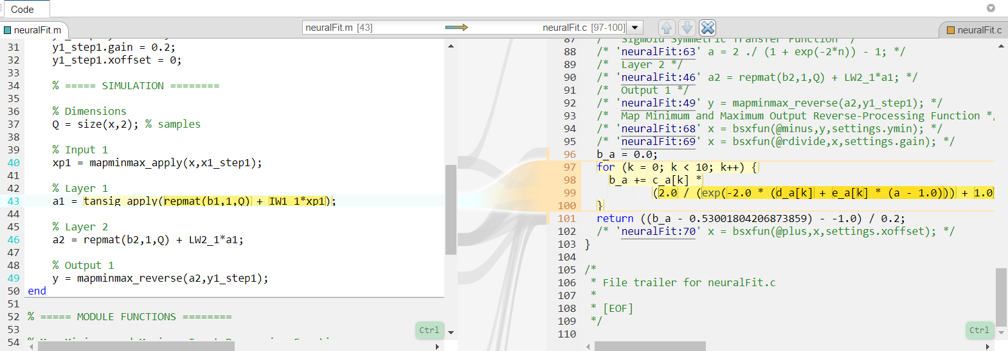
Convert MATLAB to C/C++ with MATLAB Coder

Slide 30
Call C/C++ from Python with CTYPES
import ctypes
import os
import math
# Load DLL into memory.
root = os.path.dirname(__file__)
libpath = root+"/nnlib.dll"
nnlib = ctypes.cdll.LoadLibrary(libpath)
# Define argument and result types
nnlib.neuralFit.argtypes = [ctypes.c_double]
nnlib.neuralFit.restype = ctypes.c_double
# Call library
xlist = [10.0, math.pi, math.exp(1), -9]
for x in xlist:
y = nnlib.neuralFit(ctypes.c_double(x))
print(f"nn({x}) = {y}")
nn(10.0) = 4.949738417671168
nn(3.141592653589793) = 7.639815444463722
nn(2.718281828459045) = 8.199234641809783
nn(-9) = -0.5897364132582217

Slide 31
Summary: Using MATLAB with Python
Calling IT-managed libraries in Python from MATLAB and Simulink
Calling MATLAB’s analytics from Python
Packaging MATLAB applications for deployment with Python
Desktop: MATLAB Compiler SDK
Enterprise: MATLAB Production Server
Desktop, Embedded: C/C++ Code Generation
Notes:
First challenge was calling IT-managed libraries. We saw how MATLAB has a built-in API to allow us to directly call .py libraries.
Once the data was in MATLAB, we then built a predictive analytics model which was then integrated back into Python for testing/validation (& vetting) using the MATLAB API for Python
Lastly, as we moved to production we then packaged up the MATLAB analytics and deployed them both as royalty free .py libraries and also pushed the analytics out as a service using the MATLAB Production Server.

Slide 32
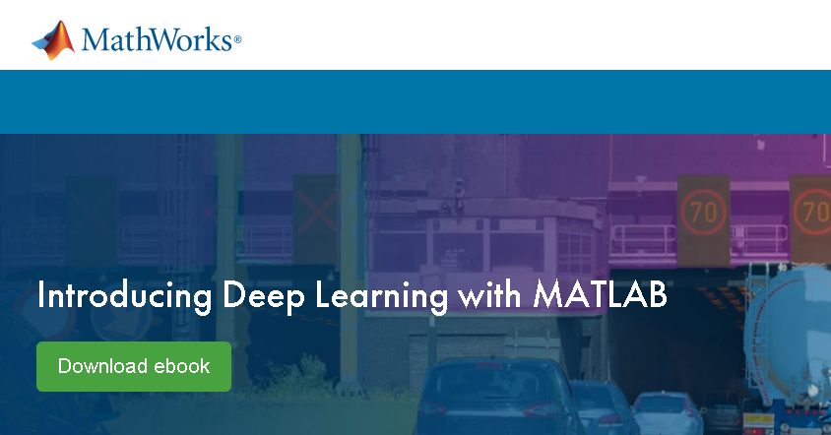
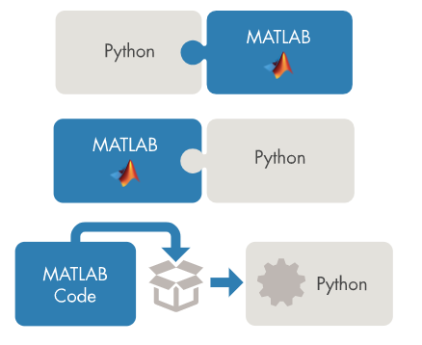
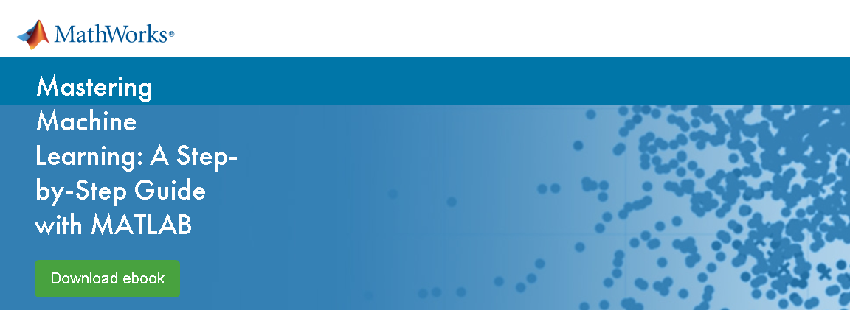
Additional Resources
MATLAB and Python
https://www.mathworks.com/solutions/matlab-and-python.html
Predictive Analytics
https://www.mathworks.com/discovery/predictive-analytics.html
Deep Learning
https://www.mathworks.com/discovery/deep-learning.html
Notes:
For more information on integrating MATLAB and Python, building machine learning or deep learning models please check out the following links which include free downloadable ebooks & interactive online tutorials to get you started with a number of topics such as deep learning.

Slide 33
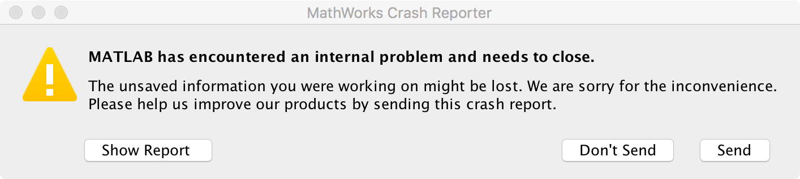
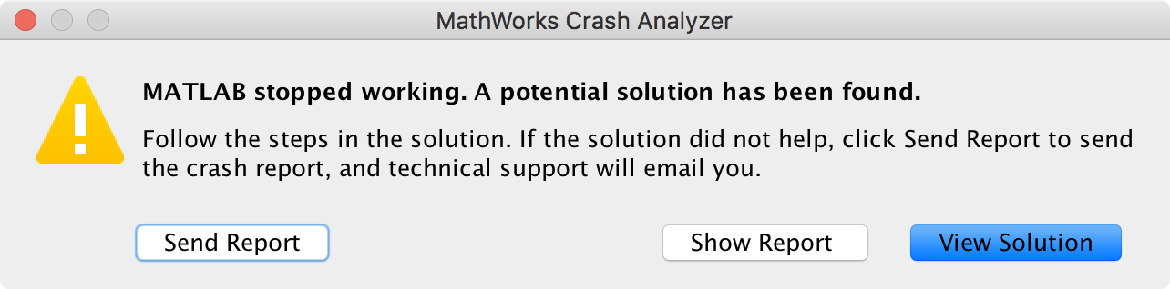
Instant Technical Support
Notes:
Debugging Crashes
Crash cases can be grouped into a few main categories:
Segmentation Violations: These are also known as segfaults, bus errors, or access violations, and can be generally summarized as an attempt to access memory that the CPU cannot physically address. In this case, the hardware will notify the operating system, which then sends a signal to the process that caused the exception. By default, the process receiving the signal dumps the contents of the section of memory at the time of the crash into a “core” file. These can occur during start-up or execution of MATLAB, but always indicate memory address failures and generate crash dumps.
MATLAB Freezing: MATLAB may freeze due to over-used hardware resources, memory leaks, infinite loops, or process hangs. This may or may not generate a crash dump.
MATLAB Disappearing: Sometimes the MATLAB process will terminate and disappear. This is often accompanied by an error window and an OS crash dump. MATLAB may or may not generate a crash dump as well if it was able to log the crash.
When you click that ‘send’ button the information is then immediately compared against a set of solutions in our tech support database using frequency analysis & text pattern matching. This way, in a few seconds you’ll get a solution to fix problems you may not have even knew existed in your application. Much better than having to determine what the problem is, formulate the problem into a question that makes sense, ask google the question, search through stack overview, and hope someone actually answered your exact question.
If a match isn’t found then a tech support case is automatically created for you to determine the issue.
Bottom line, we are here to help make your lives easier.

Slide 34
Notes:
Thanks again for taking the time today to see how you can get the best out of both worlds by combining MATLAB and Python together!

